Slide 1


Sentiment Analysis of Amazon Reviews using NLP
Project GitHub Repository Link: Click Here
I started this project by cleaning Amazon product review data using Python libraries like `re` & `string`, removing unwanted characters, numbers, symbols, and emojis. After preprocessing, I converted all text to lowercase to keep it consistent.
I then created additional features like Review Length, Word Count, Exclamation Marks Count, & Sentiment Score using TextBlob, helping the model better understand the reviews. For vectorizing the cleaned text, I used TfidfVectorizer from scikit-learn.
I trained multiple models including Logistic Regression, Random Forest, Neural Network, Naive Bayes, SVM, Voting Classifier, & LSTM, & evaluated them using cross-validated F1 Scores. Based on the comparison, the Neural Network gave the best performance. Using automatic logic, the best-performing model, along with the TF-IDF vectorizer & scaler, were saved using joblib for future predictions without needing retraining.
In addition, I used Hugging Face’s bertweet-base-sentiment-analysis model through a pipeline for side-by-side sentiment predictions in the app as a reference, but it was not included in the F1 score-based evaluation or model selection process.
To make the solution interactive, I built a Streamlit dashboard where users can type their own review or quickly select predefined examples (Positive, Neutral, Negative) using 'Try an Example' buttons. After clicking Predict, the app shows the predicted sentiment along with a Review Analysis section displaying Review Length, Word Count, Exclamation Marks, Emoji Count, & Sentiment Score. A Confidence Breakdown Pie Chart visually represents the model’s prediction probabilities, and users can easily reset all fields or download the prediction result as a CSV file.
by Debasis Baidya

Slide 2







Contributions of Key Libraries & Modules to the Project
1
2
3
4
5
Pandas & Numpy
re, NLTK & TextBlob
Matplotlib, Seaborn & WordCloud
Scikit-learn (sklearn)
Scipy.sparse
I used these for loading, cleaning, and manipulating structured data and handling numerical computations.
I used these for cleaning tweet text, removing stopwords, lemmatizing, and calculating sentiment polarity.
I used these for visualizing EDA insights like class distribution, word frequencies, and generating word clouds.
I used this for TF-IDF vectorization, building ML models, evaluating performance using accuracy, F1-score, & confusion matrix.
I used this for combining sparse TF-IDF features with engineered features like sentiment score, tweet length, and hashtag count.
📊
🤖
6
7
8
9
10
Num2words, contractions, emoji
FEE!
Transformers (Hugging Face)
Joblib & Pickle
OS & IPython.display
Streamlit
I used these for saving and loading trained models and vectorizers for real-time prediction.
I used num2words to convert numbers to words, contractions to expand shortened words, & emoji to count & analyze in the input text.
I used these for handling files/directories & improving output readability in the notebook.
I used this to build and deploy an interactive web app for real-time tweet classification.
I used this optionally to compare traditional models with state-of-the-art deep learning models.
🧩

Slide 3
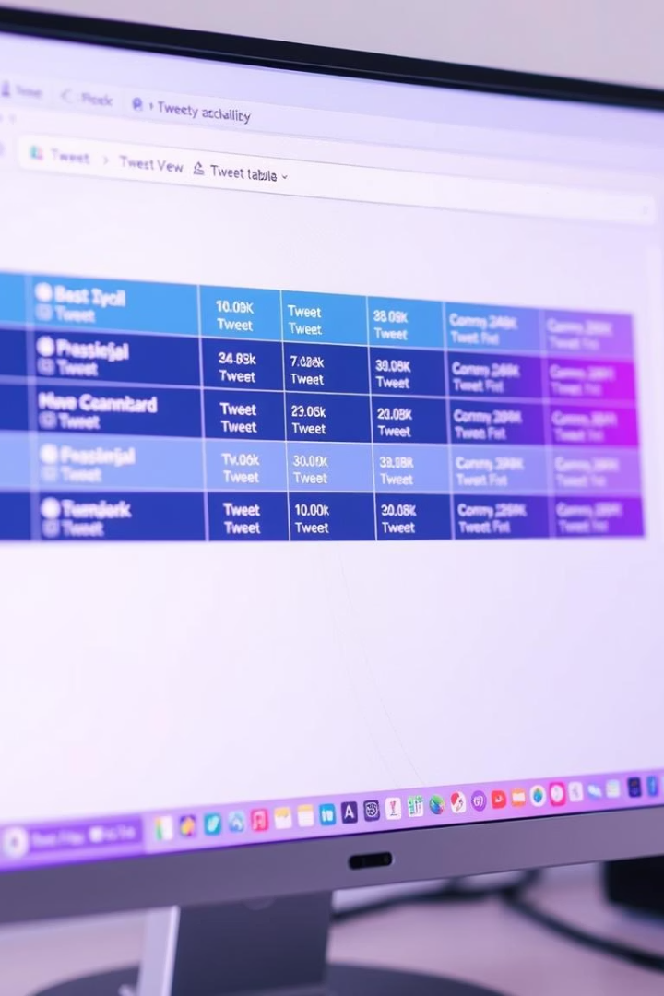
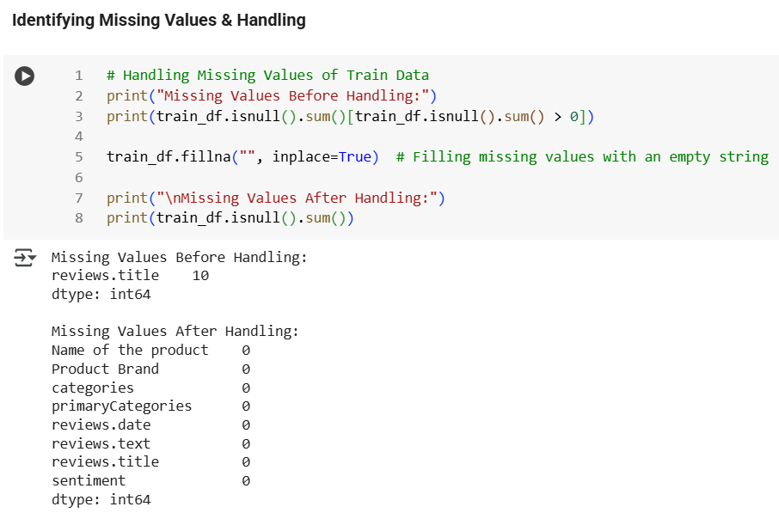
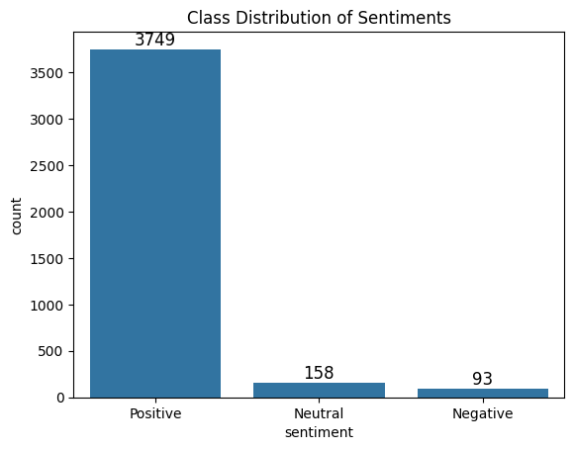
Dataset Overview
📂 Data Loading
Loaded dataset with:
train_data.csv: 4000 rows, 8 columns 📊
test_data.csv: 1000 rows, 7 columns 📑
Includes product info, reviews, and sentiment (train only).
🏗️ Dataset Overview
📋 Train Data has an extra column: sentiment (target variable).
🧠 Data Types (all columns are object type - text).
⚠️ Handling Missing Values
Train Data: reviews.title - 10 missing values.
Test Data: reviews.title - 3 missing values.
🧹 Handled by replacing with empty string (.fillna("")).
📊 Class Distribution of Sentiments
😃 Positive: 3749
😐 Neutral: 158
👿 Negative: 93
📈 Product Categories
Popular categories include Electronics, Home & Kitchen, & Clothing.

Slide 4
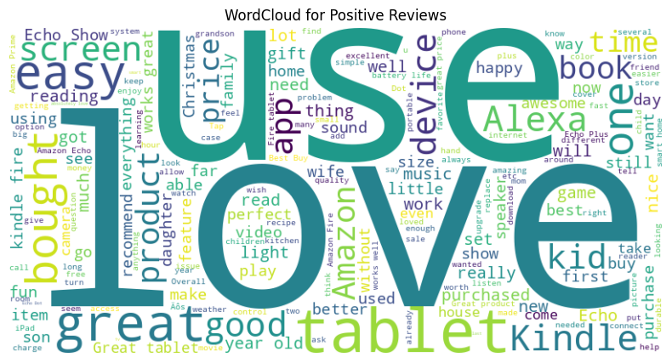
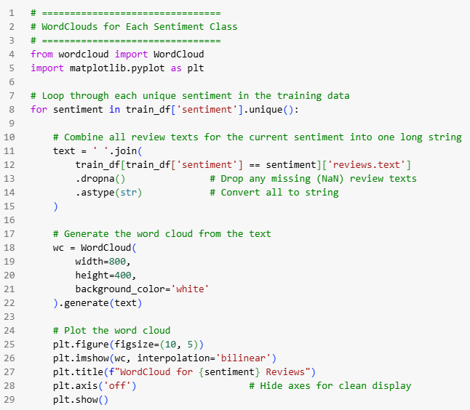
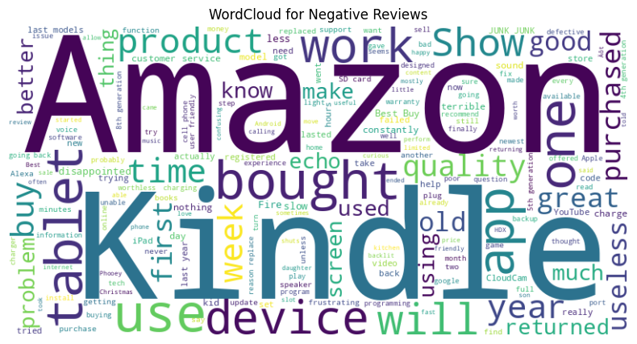
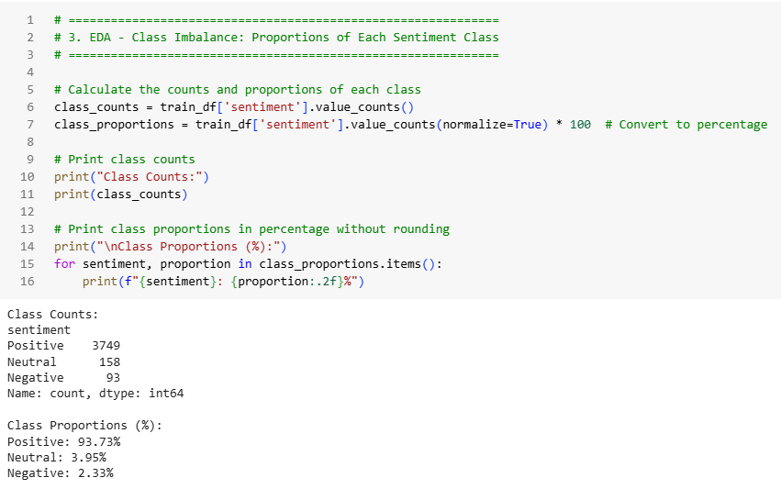
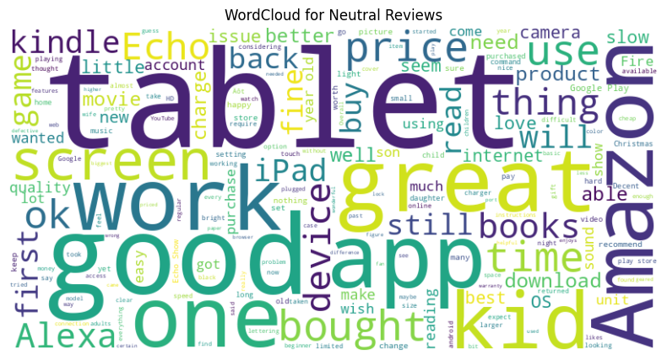
EDA & Preprocessing
📝Class Imbalance & Distribution
✔️ Positive Reviews: (93.73%) 👍 ✔️ Neutral Reviews: (3.95%) 😐
✔️ Negative Reviews: (2.33%) 👎 🎯 Outcome: Positive overwhelmingly dominates. ⚖️!
01
💬 Word Clouds for Each Sentiment
🖼️ Generated word clouds for Positive, Neutral, & Negative. 🧠 Shows unique words tied to each sentiment. ✨ Provides insights into common terms for different emotional tones.
02
🔧 Preprocessing & Text Normalization
🔤 Lowercased all text + expanded contractions (i.e. "can’t” - "cannot")
🚫 Removed stopwords, URLs, punctuation, URLs & digits
🔄 Lemmatized words for root form, prepping for model success!
03
📝 Sample Cleaned Text:
🖼️ Built a Word Cloud from tokenized words
⏫ Before:
"This product is absolutely amazing!! Sooo worth the price!"
⏬ After:
"product absolutely amazing worth price"
04

Slide 5
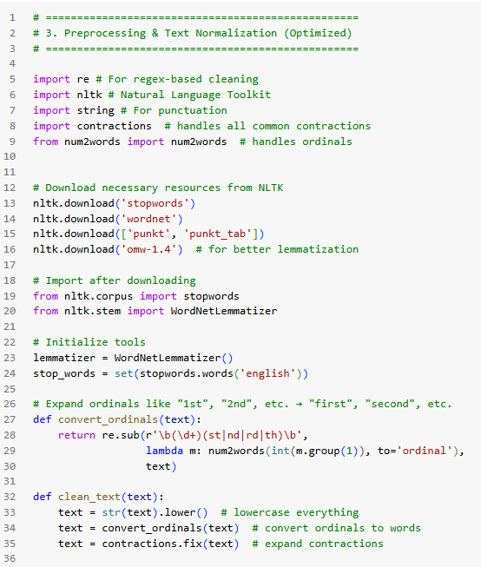
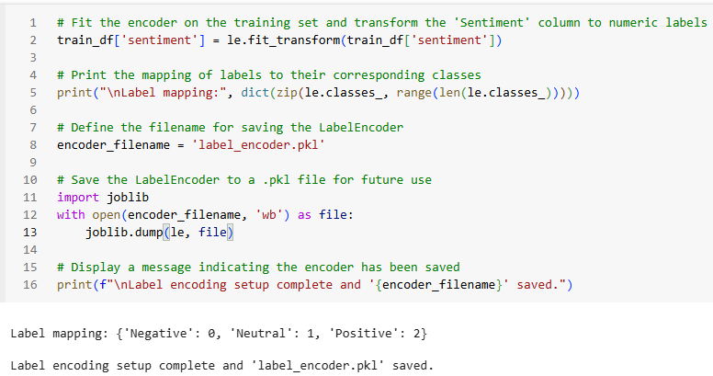
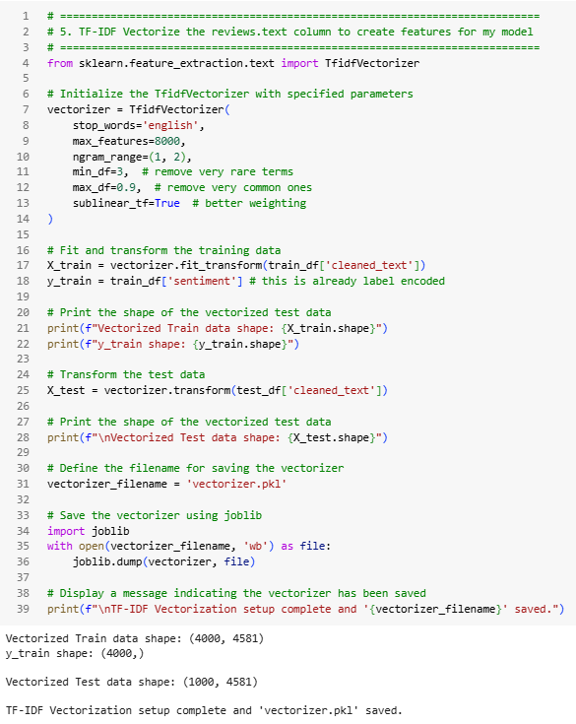
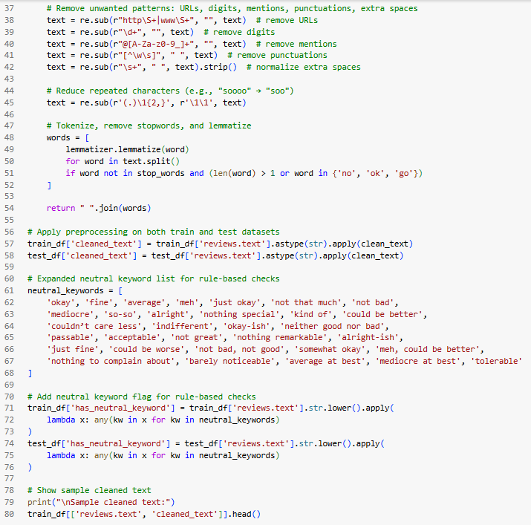
🧩 Label Encoding, TF-IDF, Feature Engineering & Tackling Imbalance
🏷️ Label Encoding of Sentiment
1
🔄 Encoded sentiment labels:
'Negative' → 0, 'Neutral' → 1, 'Positive' → 2
💾 Saved encoder as label_encoder.pkl for consistency
🔠 TF-IDF Vectorization
2
🟢 max_features=8000, ngram_range=(1, 2)
🔵 min_df=3, max_df=0.9, sublinear_tf=True for optimization
💾 Saved vectorizer as vectorizer.pkl for reuse.
🔍 Extracted review-level features
3
✍️ text_length (characters) | 🔢 word_count (words) | ❗ exclamation_count
🔗 Combined with TF-IDF vectors for enriched features.
⚖️ Tackling Class Imbalance
4
💡 Applied SMOTETomek to balance class distribution.
❌ Before: 🙂 Positive: 3749, 😐 Neutral: 158, 😡 Negative: 93
✅ After: 🙂 Positive: 3738, 😐 Neutral: 3732, 😡 Negative: 3741
📂 Saved Preprocessing Files
5
💾 Saved key preprocessing objects for future use:
label_encoder.pkl (for consistent encoding)
vectorizer.pkl (for TF-IDF transformations)
🔄 Ensures reproducibility and smooth workflow.
🔚 Summary & Readiness
6
🧹 Data is cleaned, enriched with extra features.
⚖️ Balanced for training, ready for sentiment classifier.

Slide 6
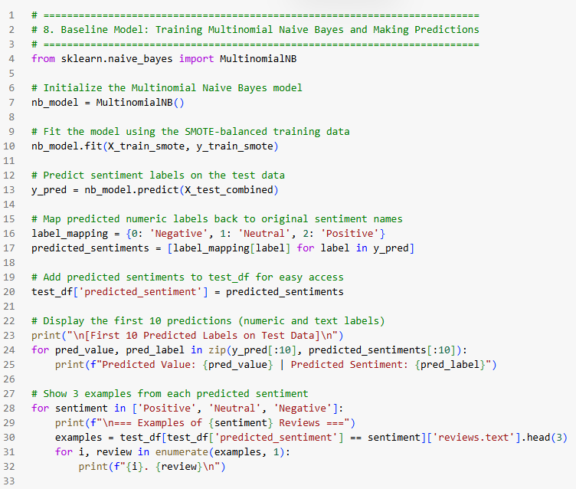
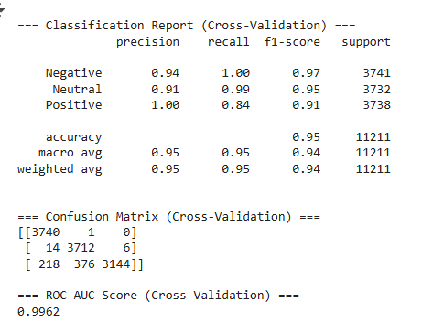
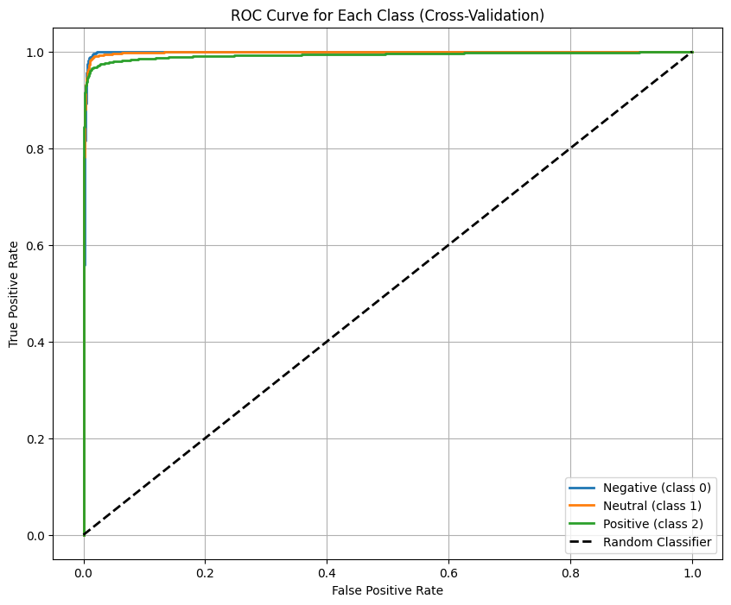
🏅 Multinomial Naive Bayes
Model Performance Overview - Accuracy & Class Metrics
🚀 Model Training
1
🛠️ Trained Multinomial Naive Bayes on SMOTE-balanced data.
📊 Predicted sentiment labels and mapped them to categories:
Negative, Neutral, Positive.
✅ Outcome: Successful sentiment prediction.
🧠 Model Evaluation
2
🔁 Used cross-validation for performance evaluation.
📊 Classification report, confusion matrix, ROC-AUC score (0.9962).
✅ Outcome: 95% accuracy, strong performance.
🧩 Confusion Matrix Insight
Neutral reviews misclassified as Positive.
✅ Outcome: Positive reviews mostly confused with Neutral.
3
📊 Classification Report
📈 Accuracy: 95%
🔻 Negative: Precision: 0.94, Recall: 1.00
⚖️ Neutral: Precision: 0.91, Recall: 0.99
🟢 Positive: Precision: 1.00, Recall: 0.84
4

Slide 7
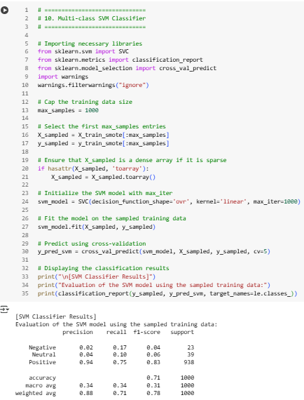
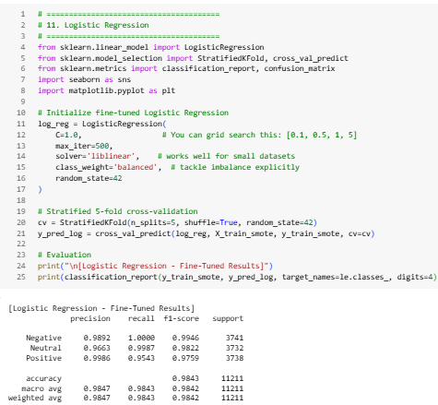


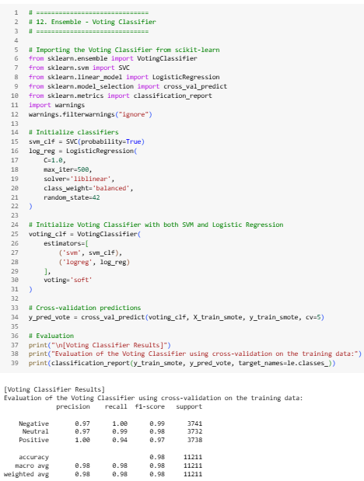
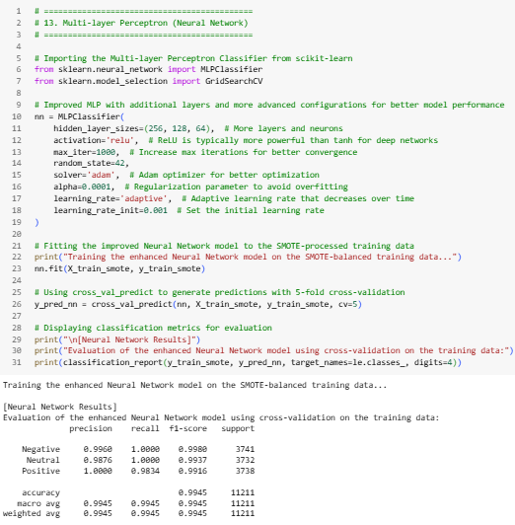

Model Testing Overview 🧪
🎯 Objective
Classify Amazon reviews into positive, neutral, and negative sentiments.
Explore the effectiveness of various machine learning models.
🧪 Models Tested:
🤖 Naive Bayes: Simple and efficient model, good baseline.
📐 SVM (Support Vector Machine): Used for creating decision boundaries.
📝 Logistic Regression: Linear classifier for multi-class problems.
🔀 Voting Classifier: Combined predictions from multiple models for better
accuracy.
🔄 Cross-Validation:
📊 F1 score (macro) was the primary metric for performance evaluation.
🔁 Used cross-validation for robust results and avoiding overfitting.
🔍 Ensured stable performance across different data splits.

Slide 8
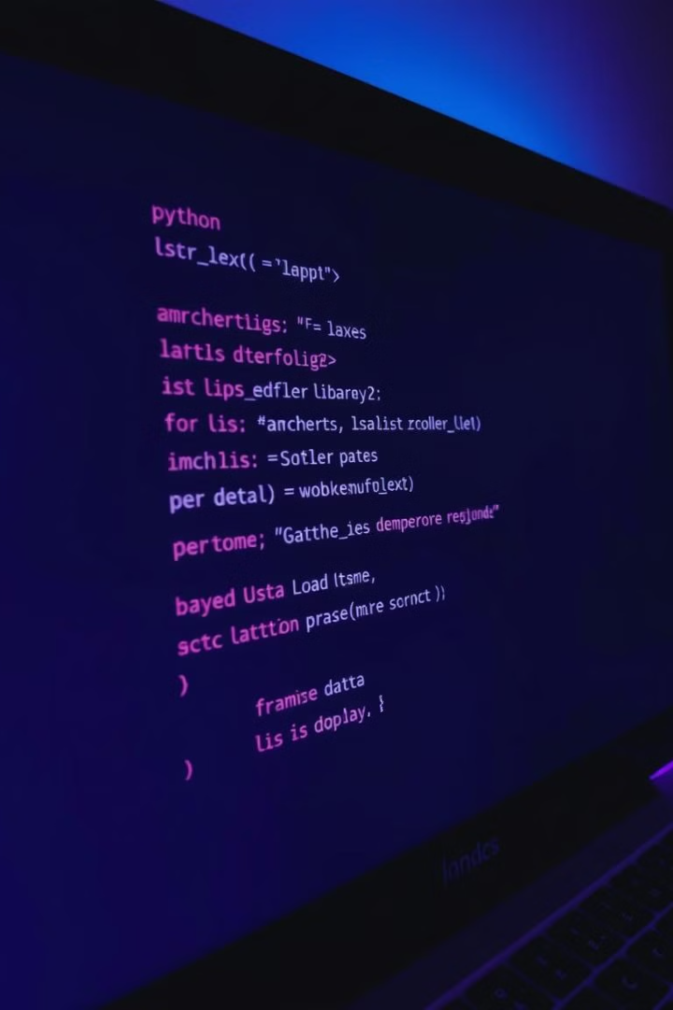
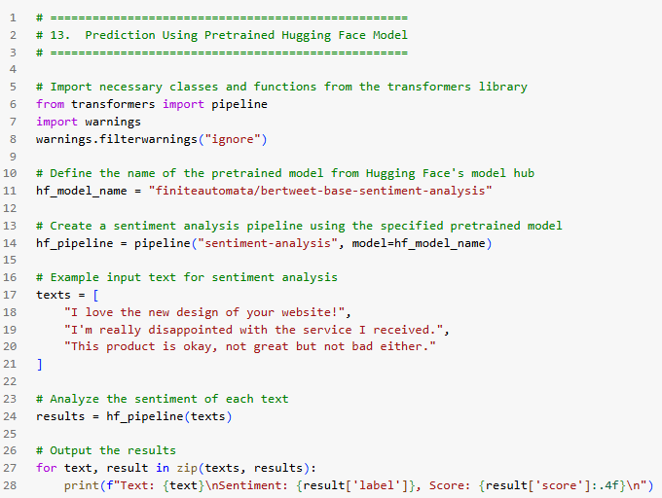
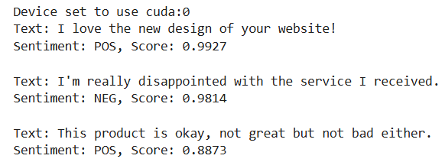
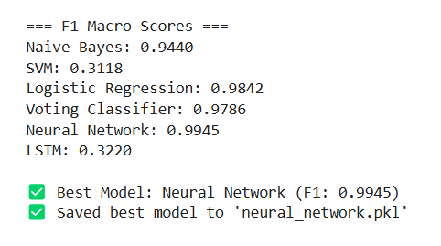
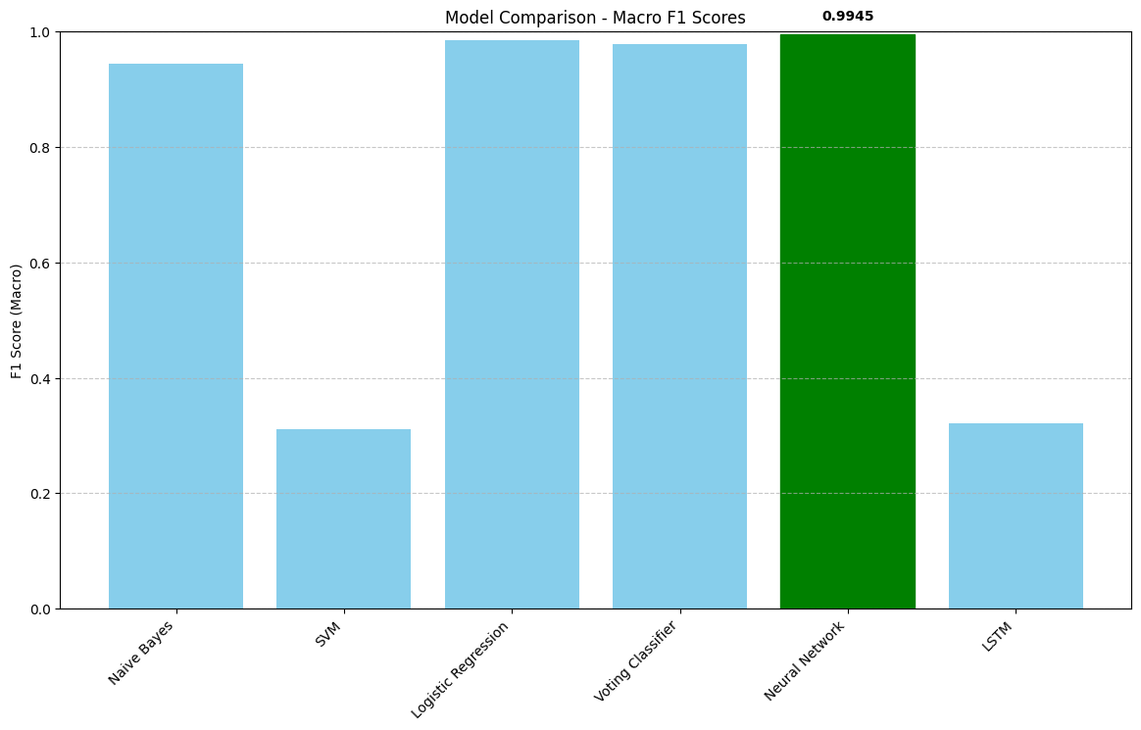
Model Performance - F1 Scores 📏
📊 F1 Scores Comparison:
1
Naive Bayes 🤖: F1 score is 0.9440, solid performance but not the best.
🔥 SVM 📐: Scored 0.3118, struggling with multi-class classification.
⚠️Logistic Regression 📝: F1 score of 0.9842, a strong contender.
✅Voting Classifier 🔀: F1 = 0.9786, strong but slightly less than Logistic Regression. 🔼
🧠 Neural Network (MLP):
2
F1 score of 0.9945 🏆, the best model overall for sentiment classification. 🌟
Outperformed all other models in both precision and recall. 🚀
📉 LSTM
3
F1 = 0.3220, poor performance, likely due to insufficient training or complex nature of the dataset.
❌Struggled with capturing sentiment from text reviews effectively. 🧩
💬 Hugging Face (BERT)
4
Not included in F1 score evaluation but used for generating predictions. 🔮
Pre-trained BERT model harnessed for more accurate, context-aware predictions. 🔍

Slide 9
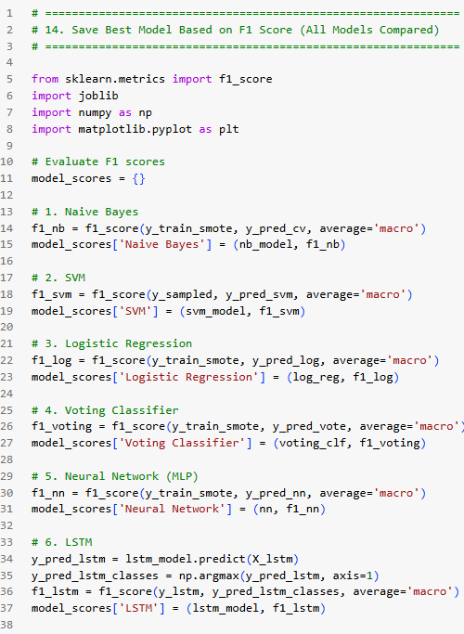
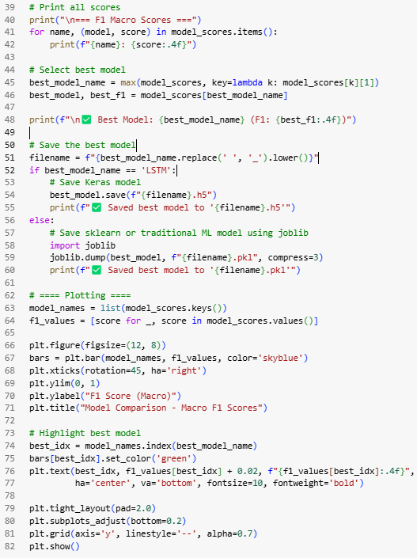
🌍 Selecting the Best Model
🛠️ Neural Network Configuration:
STEP
01
💡 Three layers with neurons: 256, 128, and 64.
⚡ ReLU activation function for hidden layers, allowing non-linear learning.
🛑 Dropout (0.3) to prevent overfitting and increase generalization.
⚙️ Adam optimizer with adaptive learning rates to improve convergence speed.
🌟 Why It Performed Best:
STEP
02
🔄 Successfully handled imbalanced data after SMOTE preprocessing.
⚖️ High precision and recall, indicating balanced performance across all classes.
🏁 Outcome
STEP
03
💯 Final model for deployment is the Neural Network (MLP), selected based on the best F1 score.
🐦‍🔥 Strong generalization to unseen data, making it ideal for real-world usage.
💾 Saved Model
STEP
04
💾 The Neural Network model was saved as neural_network.pkl for easy deployment.
⏳ Ready to be used for future predictions on new Amazon reviews.

Slide 10
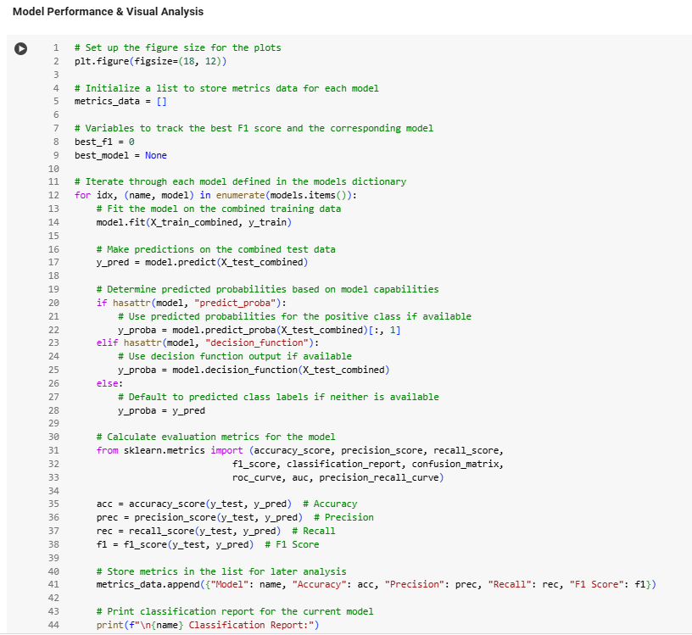
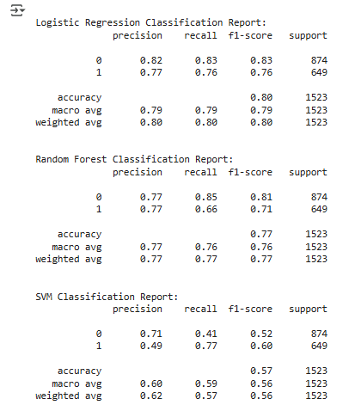
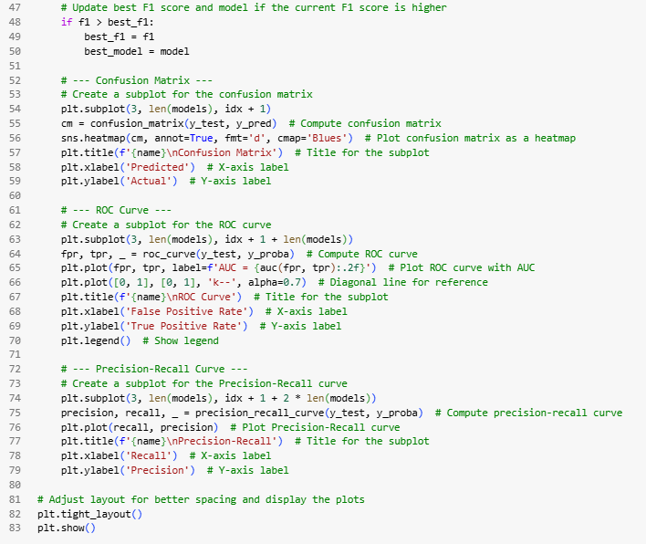
Final Conclusion & Insights 🎯
01
1️⃣ Best Model 🏆
🥇 Neural Network (MLP): F1 score of 0.9945, top performer.
⚖️ Great at handling class imbalance.
🛍️ Ideal for sentiment analysis on Amazon reviews.
02
2️⃣ 💡 Key Insights
🌟 Neural Network outperformed all models.
🤔 SVM and LSTM struggled, complex doesn’t always win.
🔧 Logistic Regression also performed well, optimizing is key.
🛠️ Focus on fine-tuning for future improvements.
03
3️⃣ 💬 Hugging Face (BERT)
🔮 Hugging Face shows potential for contextual prediction.
🚀 Can boost accuracy in future models.
🧠 Captures subtle meanings in reviews.
⏱️ Useful for real-time analysis.
04
4️⃣ Next Steps ➡️
🚀 Deploy the Neural Network (MLP) for Amazon reviews.
🌍 Integrate Hugging Face (BERT) for enhanced accuracy.
🔄 Focus on fine-tuning and ensemble methods.

Slide 11
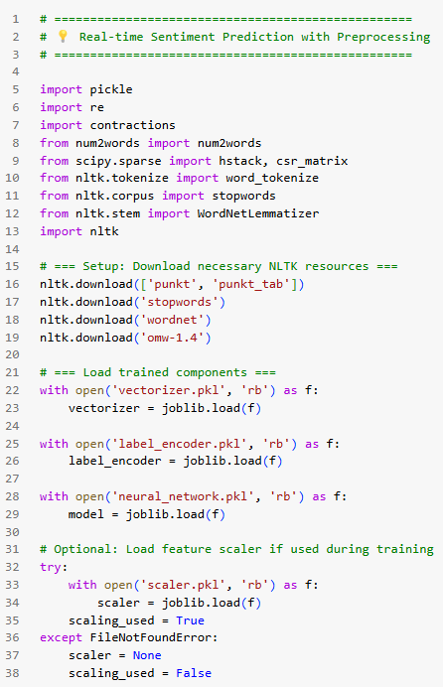
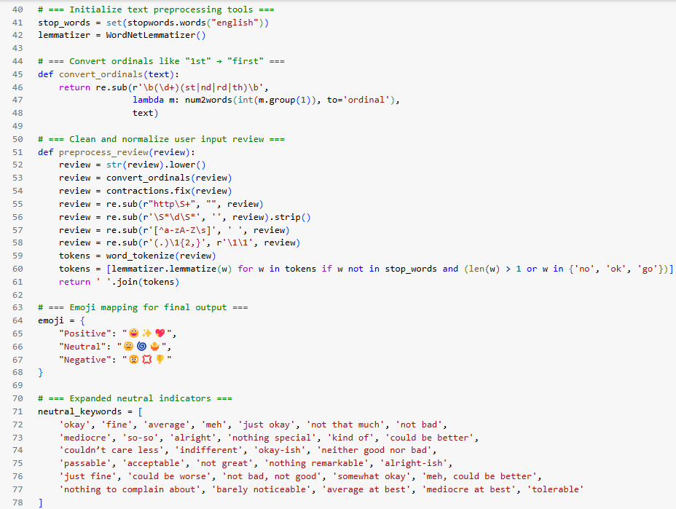
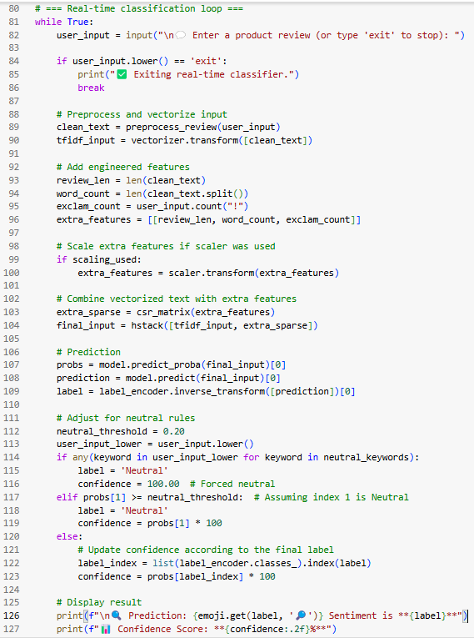
💡 Real-time Sentiment Prediction with Preprocessing
🚀 What I Build
⚙️ A real-time product review sentiment classifier
🧾 Classifies user input as:
😃 Positive
😐 Neutral
😠 Negative
01
🛠️ How It Works
🧹 Preprocesses text: contraction expansion, tokenization, lemmatization
📚 Uses pre-trained TF-IDF vectorizer + engineered features
🧠 Neural network model predicts sentiment
📲 Real-time predictions with emoji + confidence
02
🧪 Example Predictions
💬 “Absolutely love this product!” → 😃 Positive (100.00%)
💬 “It’s okay, not great.” → 😐 Neutral (100.00%)
💬 “Terrible experience. Waste of money.” → 😠 Negative (99.95%)
03

Slide 12
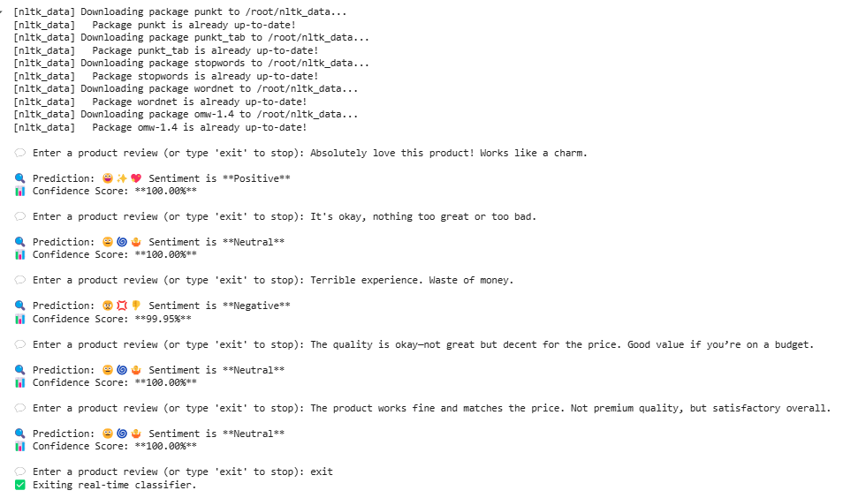
Neutral Handling & Key Outcomes ⚖️📊
01
🧠 Neutral Sentiment Handling
🧾 Created a keyword list: “okay”, “meh”, “not bad”, etc.
⚖️ Applied custom threshold logic to classify borderline cases as Neutral
🛡️ Prevents misclassification of mixed-tone reviews
02
🎯 What I Achieved
🚀 Built a reliable real-time sentiment prediction system
🤖 High accuracy across all 3 classes.
🔁 Instant feedback loop – fast and responsive
🌟 Final Outcome
03
03
📊 Output includes confidence score and emoji sentiment
✅ Covers all 3 sentiment types effectively
💼 Ideal for dashboards, review systems, or feedback tools

Slide 13
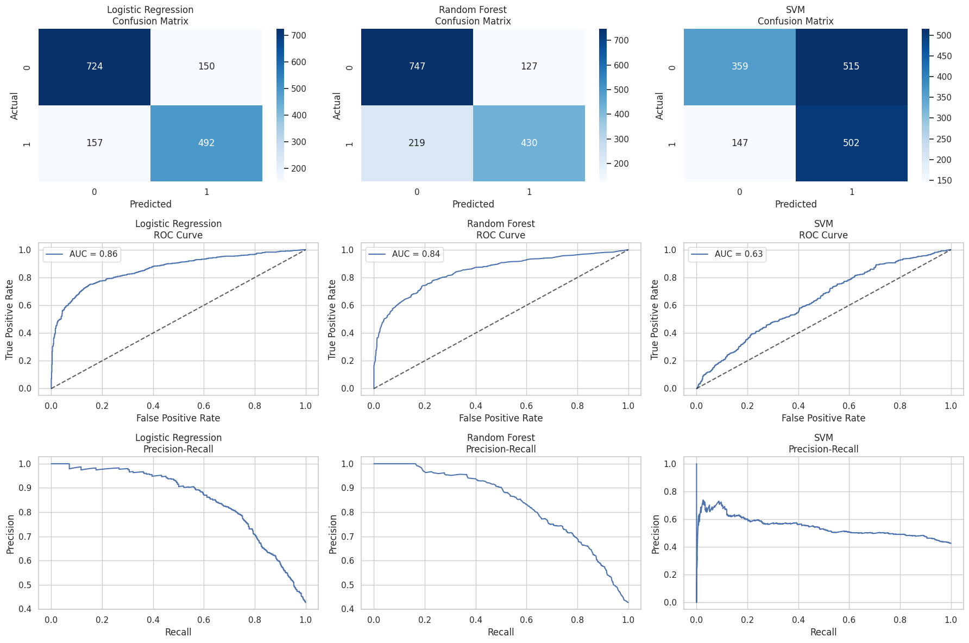
Visual Evaluation – What the Charts Say
✅ Confusion Matrices:
📈 ROC Curves:
📉 Precision-Recall Curves:
Logistic Regression: Strong diagonals, better class distinction
SVM: Lighter matrix, more errors & confusion
Logistic Regression:
Tops with AUC ~0.86
Random Forest:
Close second with AUC ~0.84
SVM:
Lowest, AUC ~0.63
Logistic Regression:
High precision across recalls
Random Forest:
Steady, but dips slightly
SVM:
Sharp drop, lower overall precision

Slide 14
📱 Amazon Review Sentiment Classifier – Features & Functionality
🔗 Live Streamlit App Link: 📦 Amazon Reviews Sentiment Analyzer 🛒💳
🎥 All About My Streamlit App: Click to Watch (CTRL + Click)▶️
🛍️ Classifies Amazon Reviews
📊 Tweet Analysis
STEP
01
STEP
06
Extra insights like Sentiment, Review Length, Exclamation count, Word Count, and emoji count 🧠.
Built a clean, easy-to-use app to classify reviews as 😊 Positive, 😐 Neutral, or 😡 Negative
✍️ Live Input or Example Tweets
⬇️ Download Prediction
STEP
02
STEP
07
Enter your own real product reviews or click an example to auto-fill instantly 🚀.
Exports your input and prediction to a CSV file with just one click 📥.
🔍 Predict Button
⚡ Fast & Smooth UX
STEP
03
STEP
08
One click analyzes the review, predicts category, shows confidence % and tone 🎯.
Streamlit-based UI for quick, interactive, and user-friendly experience.
🧹 Reset All
🤖 Powered By
STEP
04
STEP
09
One click clears results, double click clears tweet input too for a full reset 🧼✨.
Neural Network 🤖 | TF-IDF 📊 + Engineered Features 🛠️
📈 Confidence Breakdown
🚀 Real-World Ready
STEP
05
Neat pie chart showing prediction probabilities side-by-side 🍰.
STEP
10
Prediction, visualization, and reset all work instantly without weird reloads 🚀.
FRE!

Slide 15
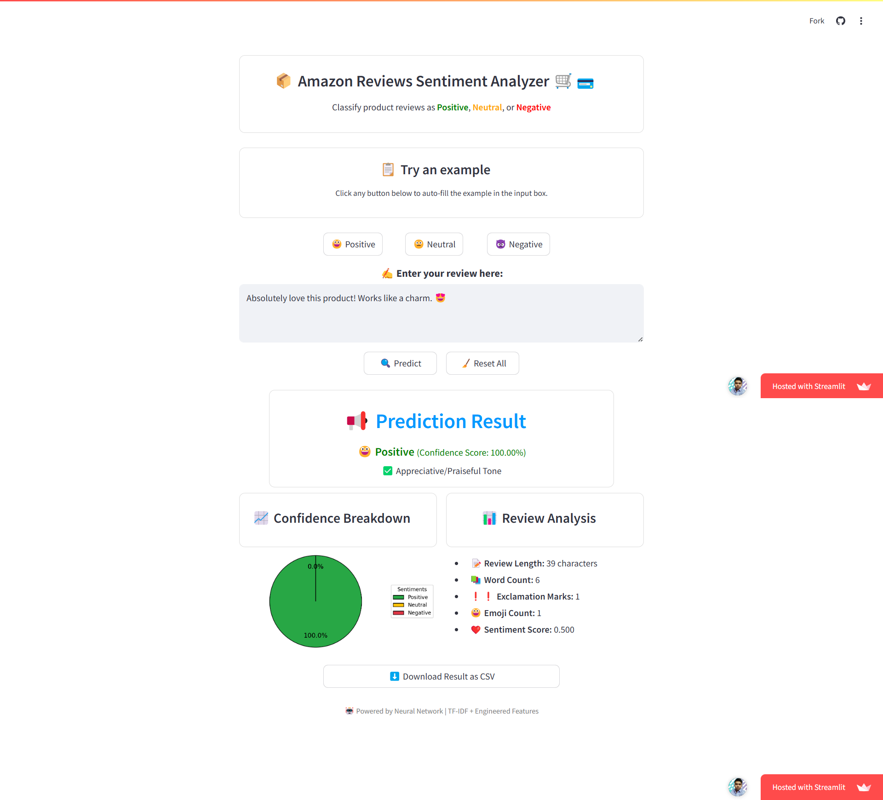
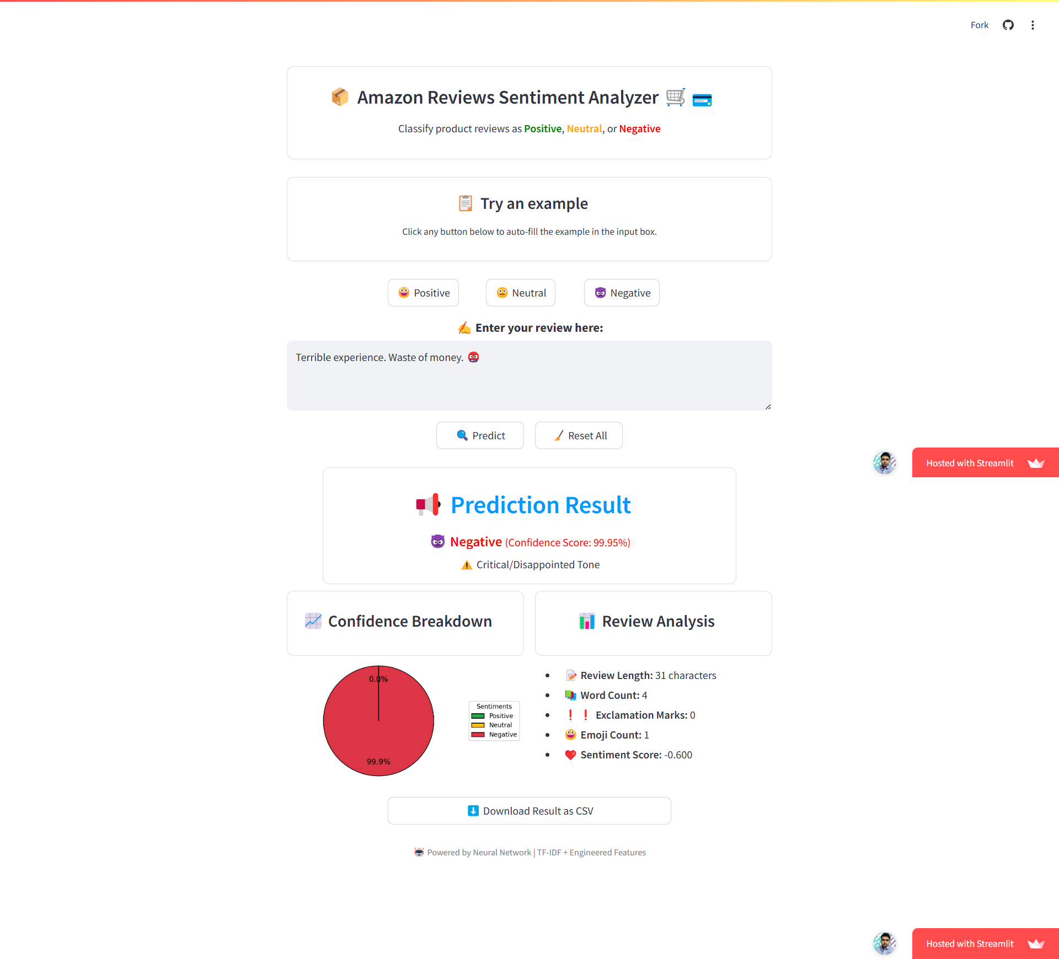
🎨 Sleek & User-Friendly Streamlit Interface for
Real-Time Amazon Review Analysis
01
🔵 Centralized Layout
Every button, example, & output is thoughtfully center-aligned for a clean, professional look 🎯
02
🟠 Instant Example Loading
Example Reviews load immediately into the input box without refreshing the page. ⚡
03
🟣 Consistent Design
Matching boxed sections for prediction, analysis & pie charts keep the UI smooth & intuitive. 🎨
04
⚡ Real-Time Prediction
Instant feedback with minimal delay to classify product reviews or any text data globally.

Slide 16


Summary
Future Enhancements
Q&A
I hope you found this presentation helpful and informative. 🙂
Please don't hesitate to contact me with any questions or feedback you may have.
I am more than eager to hear your thoughts and suggestions.

